Slide 1

TaCare
Feel Better - Live Longer

Slide 2
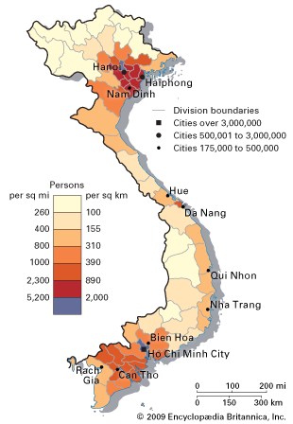


90,000,000
a haft of them
Knowledge of first-aid in case of emergency
Reliable information about diseases and treatments

Slide 4


Slide 5


Slide 6
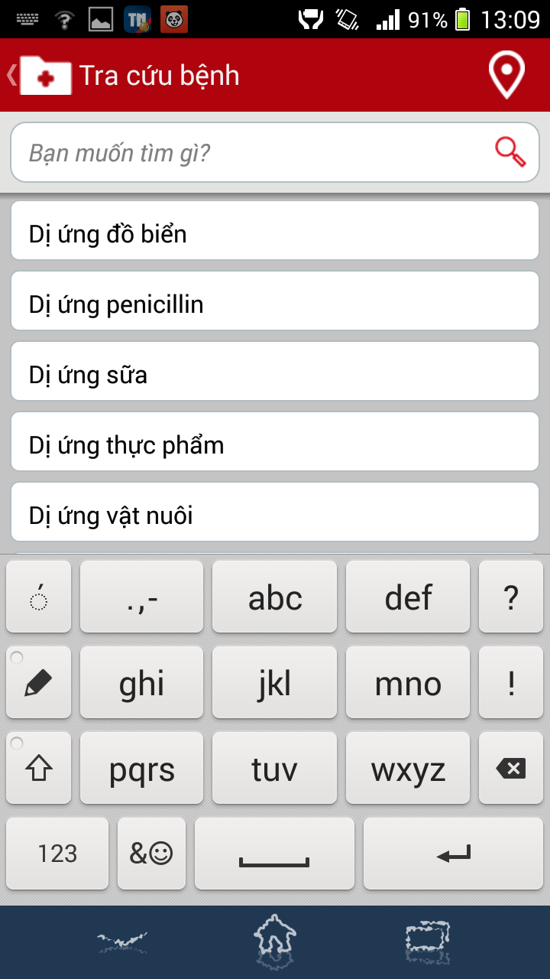

Slide 7
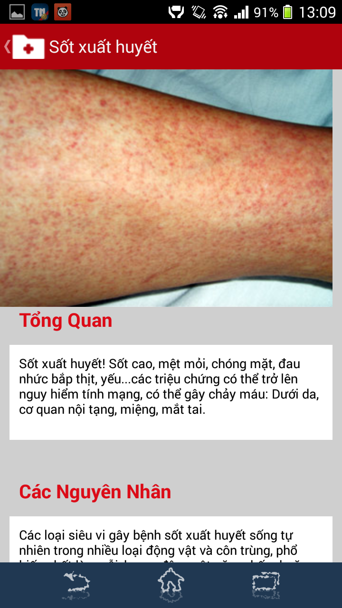

Slide 8
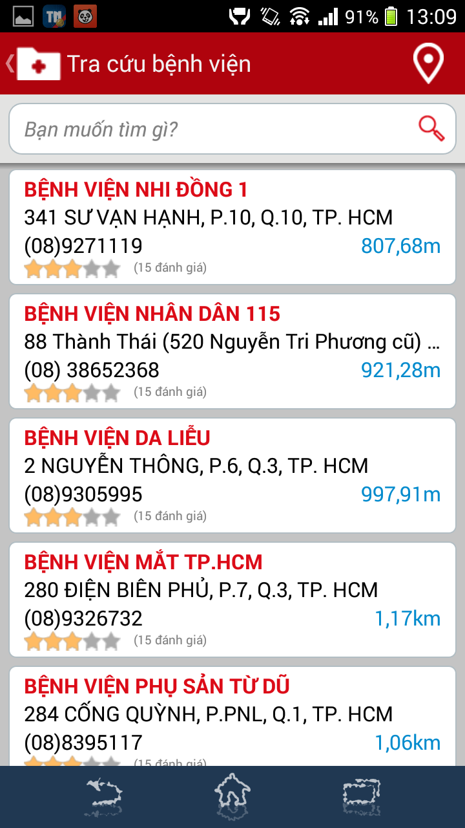

Slide 9
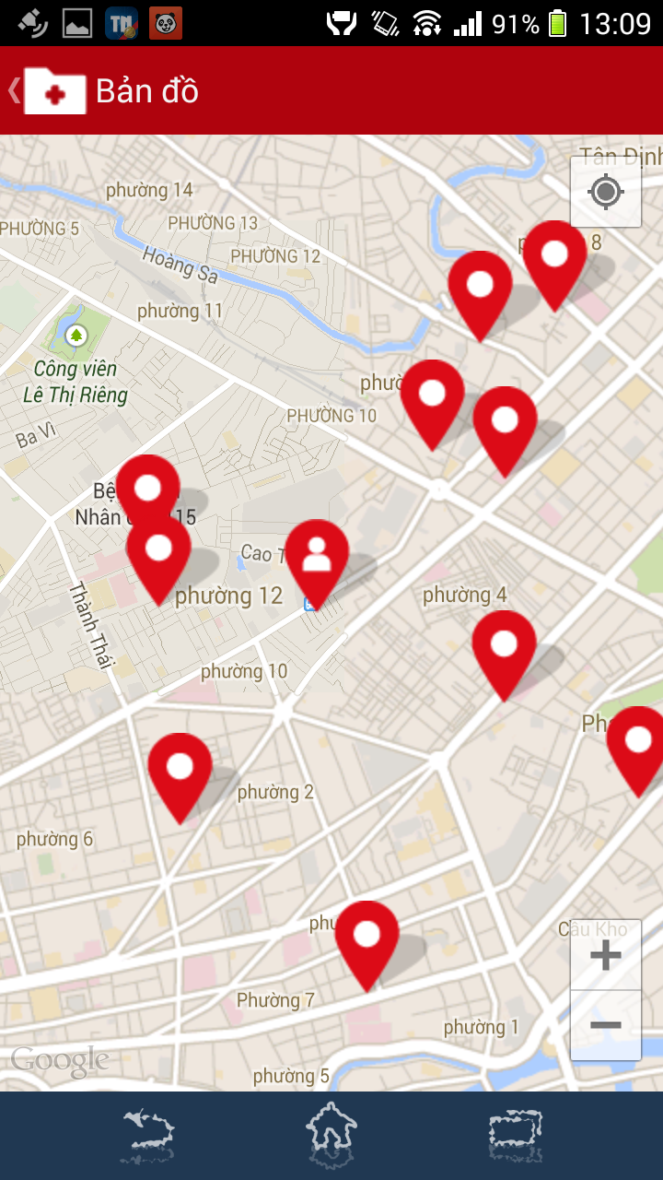

Slide 10
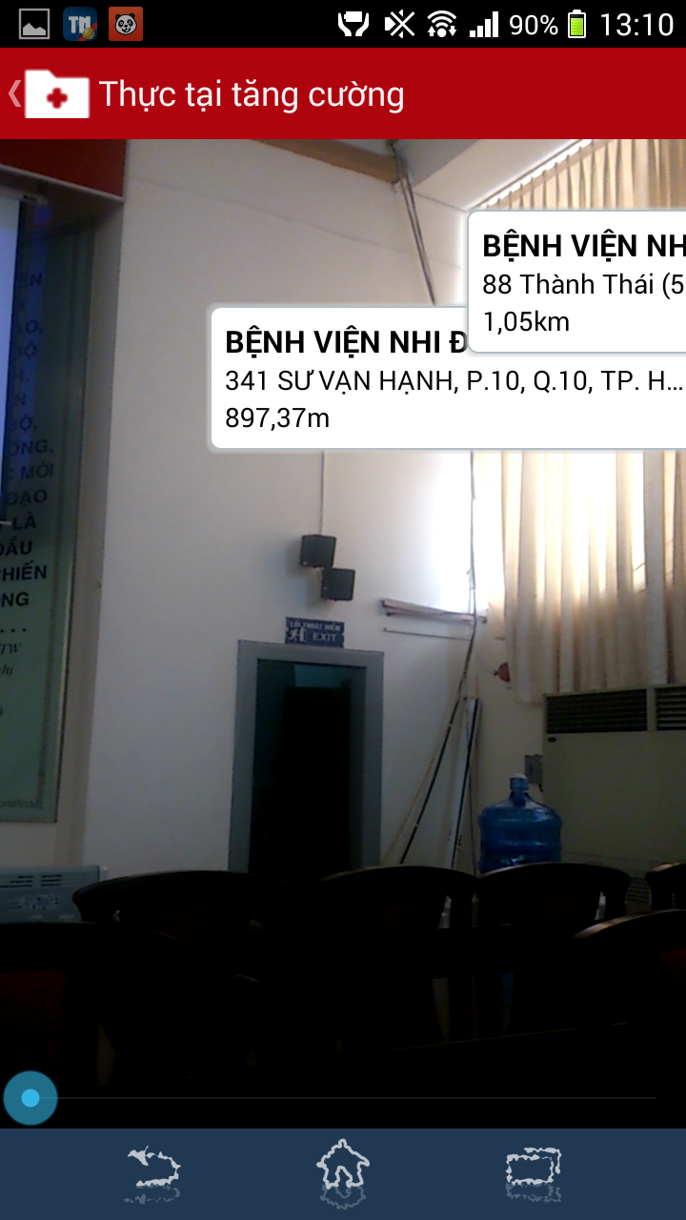

Slide 11
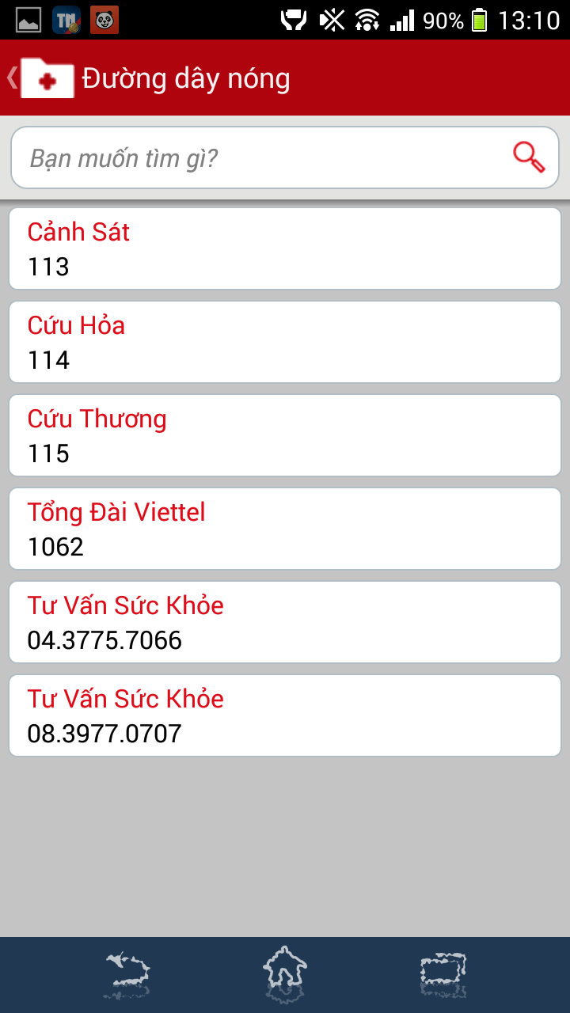

Slide 12
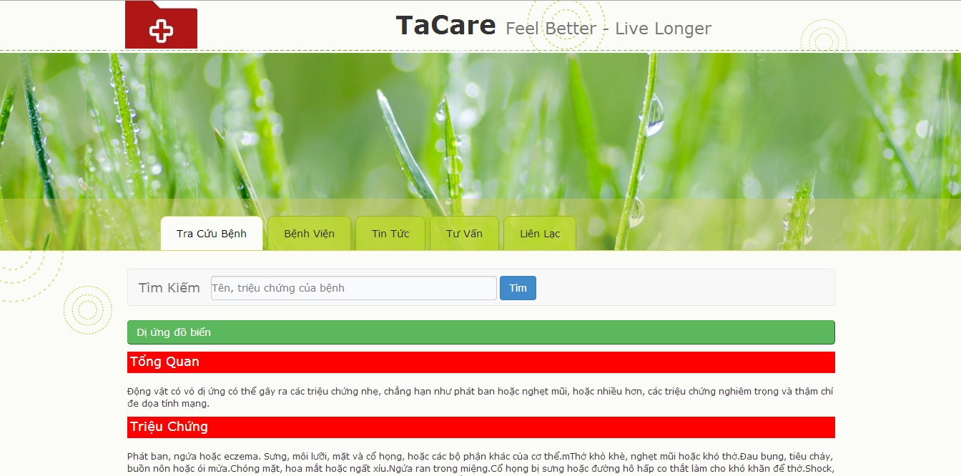

Slide 13


Slide 14
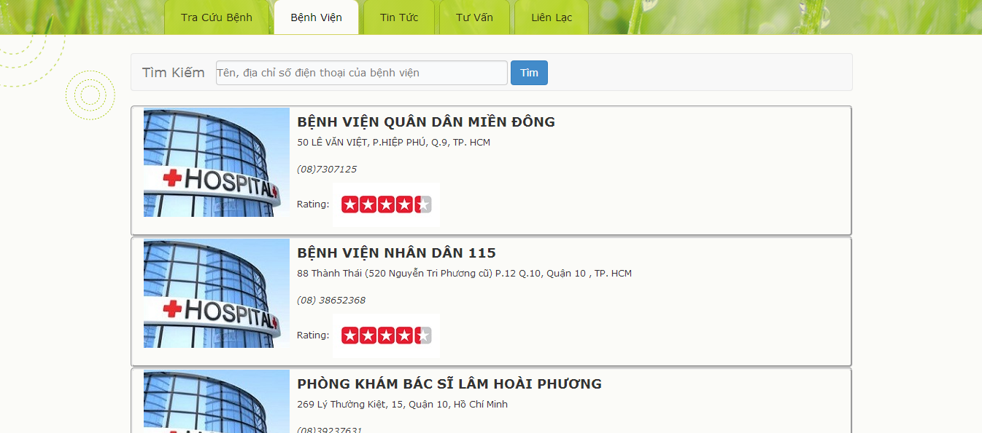

Slide 15


Slide 16


Slide 17
Our Vision
TaCare
News
Profiles
Care Packages
Online Health Consultant

Slide 18
Market Size
1st
2st
3rd
Central Cities in VietNam:
HoChiMinh
HaNoi
DaNang
CanTho…

Slide 19
Market Size
1st
2st
3rd
Sub-urban:
Thu Duc
Distric 12
Ben Luc….

Slide 20
Market Size
1st
2st
3rd
Nearby Countries:
ThaiLand
China
Laos..

Slide 21
Market Size
3 years
5 690 460
1st
2st
3rd
Nearby Countries:
ThaiLand
China
Laos..
Sub-urban:
Thu Duc
Distric 12
Ben Luc….
Central Cities in VietNam:
HoChiMinh
HaNoi
DaNang
CanTho…

Slide 22
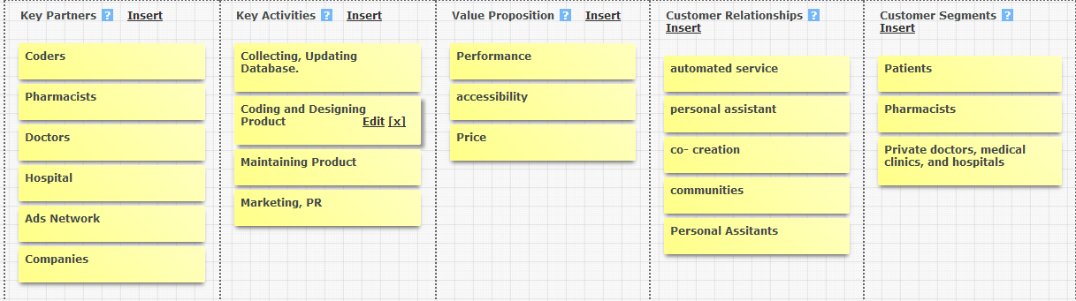
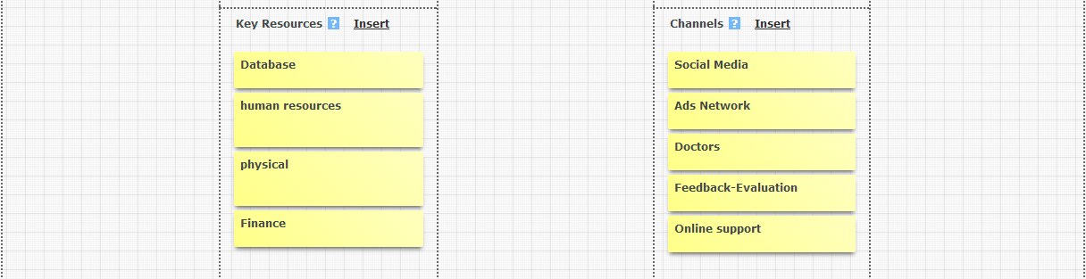
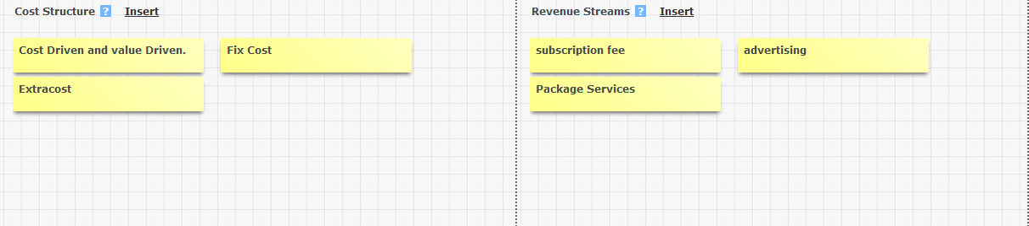
Business Model

Slide 23
Revenue Streams
TaCare
Subscription
Ads Network
User documents =>> ads
User location => doctor address

Slide 24
Costs Stucture
TaCare
Licenses
Database
System
HR
Marketing
=>> Cost: around $16,500 USD

Slide 25
Chanels
TaCare
PR
Social Marketing
Ads Network
=>> Main Focus: Doctors, Hospitals
=>> Survey -> Feedback

Slide 26
Why TaCare?
Convenient to use
With amazing functions
Reliable information

Slide 27
Why TaCare?
It’s not only for you…
but also for your family
And a better society!

Slide 28
Our Team
PASSION
KNOWDLEGE
University of Medicine
- Producer - Innovator
Nguyen Thanh Xuan
University of Technology - Evangelist
Le Hoai Trung
Lake Forest College – Administrator
Tran Thi Thuy Linh
Nguyen Cong Chanh
Ho Minh Nhat
Carleton University – Coder -Intergrator
University of Science – Coder - Innovator
EXPERIENCE

Slide 29
Our Advisors
Director engineering KMS
Nguyen Van Vu
Senior engineering KMS
Lam Phuong Duy
Doctor
Tran Van Tu
Huynh Bao Tuan
Master Degree in Economics

